Slide 1
NP-Complete Problems
Algorithm : Design & Analysis
[21]

Slide 2
In the last class…
Decision Problem
The Class P
The Class NP
  Nondeterministic algorithm

Slide 3
In this class
NP-Complete Problems
  Many of the problems for which there is no known polynomial time algorithm are computationally related

Slide 4
Solving a Problem Indirectly
T(x)
x
T
Algorithm for Q
an input for Q
yes or no
answer
(an input for P )
Algorithm for P
The correct answer for P on x is yes if and only if the correct answer for Q on T(x) is yes.

Slide 5
Polynomial Reduction
Let T be a function from the input set for a decision problem P into the input set for Q. T is a polynomial reduction from P to Q if:
  T can be computed in polynomial bounded time
  x is a yes input for P → T(x) is a yes input for Q
  x is a no input for P → T(x) is a no input for Q
An example:
P: Given a sequence of Boolean values, does at least one of them have the value true?
Q: Given a sequence of integers, is the maximum of them positive?
T(x₁, …, x_{n})= (y₁, …, y_{n}), where: y_{i}=1 if x_{i}=true, and y_{i}=0 if x_{i}=false

Slide 6
Relation of Reducibility
Problem P is polynomially reducible to Q if there exists a polynomial reduction from P to Q, denoted as: P≤_{P}Q
If P≤_{P}Q and Q is in P, then P is in P
  The complexity of P is the sum of T, with the input size n, and Q, with the input size p(n), where p is the polynomial bound on T,
  So, the total cost is: p(n)+q(p(n)), where q is the polynomial bound on Q.
  (If P≤_{P}Q, then Q is at least as “hard” to solve as P)

Slide 7
NP-complete Problems
A problem Q is NP-hard if every problem P in NP is reducible to Q, that is P≤_{P}Q.
  (which means that Q is at least as hard as any problem in NP )
A problem Q is NP-complete if it is in NP and is NP-hard.
  (which means that Q is at most as hard as to be solved by a polynomially bounded nondeterministic algorithm)

Slide 8
An Example of NP-hard problem
Halt problem: Given an arbitrary deterministic algorithm A and an input I, does A with input I ever terminate?
  A well-known undecidable problem, of course not in NP .
  Satisfiability problem is reducible to it.
    Construct an algorithm A whose input is a propositional formula X. If X has n variables then A tries out all 2^{n} possible truth assignments and verifies if X is satisfiable. If it is satisfiable then A stops. Otherwise, A enters an infinite loop.
    So, A halts on X iff. X is satisfiable.

Slide 9
P and NP : Revisited
Intuition implies that NP is a much larger set than P.
  The number of possible s is exponential in n.
  No one problem in NP has been proved not in P.
If any NP-completed problem is in P , then NP =P .
  Which means that every problems in NP can be reducible to a problem in P !
  Much more questionable!!

Slide 10
First Known NP-Complete Problem
Cook’s theorem:
  The satisfiability problem is NP-complete.
Reduction as tool for proving NP-complete
  Since CNF-SAT is known to be NP-hard, then all the problems, to which CNF-SAT is reducible, are also NP-hard. So, the formidable task of proving NP-complete is transformed into relatively easy task of proving of being in NP.

Slide 11
Procedure for NP-Completeness
Knowledge: P is NP-completeness
Task: to prove that Q is NP-complete
Approach: to reduce P to Q
  For any R∈NP , R ≤_{P} P
  Show P ≤_{P} Q
  Then R ≤_{P} Q, by transitivity of reductions
  Done. Q is NP-complete

Slide 12
Proof of Cook’s Theorem
COOK, S. 1971.
The complexity of theorem-proving procedures.
In
Conference Record of
3rd Annual ACM Symposium on Theory of Computing.
ACM New York, pp. 151–158.
Stephen Arthur Cook: b.1939 in Buffalo, NY. Ph.D of Harvard. Professor of Toronto Univ. 1982 Turing Award winner. The Turing Award lecture: “An Overview of Computational Complexity”, CACM, June 1983, pp.400-8

Slide 13
Reduction
Bounds of NP-Completeness
Proving NPC by Reduction
Examples of Reduction
  Max Clique
  Hamiltonian Graph
  Subset Sum and Job Scheduling

Slide 14
NPC as a Level of Complexity
If P is a NP-complete problem, then:
  If there is a polynomial bounded algorithm for P, then there would be a polynomial bounded algorithm for each of the problems in NP.
  P is as difficult to be solved as that no problem in NP is more difficult than P; and P is as easy to be solved as that there exists a polynomially bounded nondeterministic algorithm which solves P.

Slide 15

Satisfiability Problem
CNF
  A literal is a Boolean variable or a negated Boolean variable, as x or
  A clause is several literals connected with ∨s, as (x₁∨ ₂ )
  A CNF formula is several clause connected with ∧s
CNF-SAT problem
  Is a given CNF formula satisfiable, i.e. taking the value TRUE on some assignments for all x_{i}.
A special case: CNF-3-SAT

Slide 16
Proving NPC by Reduction
The CNF-SAT problem is NP -complete.
Prove problem Q is NP-complete, given a problem P known to be NP -complete
  For all R∈NP, R≤_{P}P;
  Show P≤_{P}Q;
  By transitivity of reduction, for all R∈NP, R≤_{P}Q;
  So, Q is NP-hard;
  If Q is in NP as well, then Q is NP-complete.

Slide 17

Max Clique Problem is in NP
Example 1: Max Clique Problem is NPComplete
void nondeteClique(graph G; int n, k)
set S=φ;
for int i=1 to k do
int t=genCertif();
if t∈S then return;
S=S∪{t };
for all pairs (i,j) with i,j in S and i≠j do
if (i,j ) is not an edge of G
then return;
Output(“yes”);
In O(n)
In O(k²)
So, we have an algorithm for the maximal clique problem with the complexity of O(n+k²)=O(n²)

Slide 18
CNF-SAT to Clique
Let φ=C₁∧C₂∧...∧C_{k} be a formula in CNF-3 with k clauses. For r =1,2,...,k, each clause C_{r}=(l₁^{r}∨l₂^{r}∨l₃^{r}), l_{i}^{r} is x_{i} or ¬x_{i}, any of the variables in the formula.
A graph can be constructed as follows. For each C_{r}, create a triple of vertices v₁^{r}, v₂^{r} and v₃^{r}, and create edges between v_{i}^{r} and v_{j}^{s} if and only if:
  they are in different triples, i.e. r≠s, and
  they do not correspond to the literals negating each other
  (Note: there is no edges within one triple)

Slide 19



The Graph Corresponding 3-CNF
C₁
x₁
¬x₂
¬x₃
Two of satisfying assignments:
x₁=1/0, x₂=0; x₃=1, or
x₁=1, x₂=1/0, x₃=1
For corresponding clique, pick one “true” literal from each triple
C₂
¬x₁
x₁
x₂
x₂
x₃
C₃
x₃

Slide 20
Clique Problem is NP-Complete
φ, with k clauses, is satisfiable if and only if the corresponding graph G has a clique of size k.
Proof: ⇒
  Suppose that φ has a satisfying assignment.
  Then there is at least one “true” literal in each clause. Picking such a literal from each clause, their corresponding vertices in G can be proved to be a clique, since any two of them are in different triples and cannot be complements to each other(they are both true).

Slide 21
Clique Problem is NP-Complete
φ, with k clauses, is satisfiable if and only if the corresponding graph G has a clique of size k.
Proof: ⇐
  Suppose that G has a clique V’ of size k.
  Note there is no edge within one triple, so V’contains exactly one vertex from each triple. Assigning “true” to the literal corresponding to every vertices in V’, no inconsistency will be resulted according to the rule by which the graph is constructed. The assignment is a satisfying assignment. (The variables whose corresponding vertices are not in V’ can be assigned either 0 or 1.)

Slide 22
CNF-3-SAT to Hamiltonian Path
Example 2: Hamiltonian Path Problem is NPComplete
Let φ=C₁∧C₂∧...∧C_{k} be a formula in 3-CNF with k clause. For r=1,2,...,k, each clause C_{r}=(l₁^{r}∨l₂^{r}∨l₃^{r}), l_{i}^{r} is x_{i} or ¬x_{i}, any of the variables in the formula.
Construct a graph as follows:
  For any variable x_{i}, create a structure as the lower left
  For any clause C_{r}=, create a single node, as the lower right
…
C_{r}
x_{i}

Slide 23
Assembling the Graph - I
First step: C_{r} unlinked
s
Horizontal row: details
x₁
……
end vertex
separator vertex
x₂
……
…
C₁
C₂
……
There are 3k+3 nodes in the row
x_{l}
t

Slide 24
Assembling the Graph - I
Step 2: link clause vertices to variable vertices
C_{j}
Traversing the diamond
C_{j} contains x_{i}
……
x_{i}
C_{j}
C_{j}
x_{i} assigned “true”
C_{j} contains ¬x_{i}
……
x_{i}
C_{j}
x_{i} assigned “false”

Slide 25
Hamilton Path Problem is NPC
Hamilton Path problem is in NP
  A certificate can be verified in polynomial time
φ is satisfiable if and only if the graph constructed as the above has a Hamiltonian path from s to t.
  ⇒ The existence of the required Hamiltonian path is guaranteed by the assigned directions of the links between the rows in diamonds and the clause vertices. (normal traversal)

Slide 26
Hamilton Path Problem is NPC
(cont.) φ is satisfiable if and only if the graph constructed as the above has a Hamiltonian path from s to t.
  ⇐ Note that the situation as the lower left is impossible
Hamiltonian path must be normal
C
Under this situation, the vertex v can’t be included in the H-path, either it is a separator or not(then the vertex to its right must be a separator)
v
Given a H-path, an assignment of true value can be made, in which the value of each variable is determined by the directions by which the path hits the horizontal row in each diamond

Slide 27
Turning Directed G into Undirected
Example 3: Directed Hamiltonian reducible to Undirected
G
G’
u
u¹
u²
u³
y
v
z
y¹
y²
y³
v¹
v²
v³
x
w
z¹
z²
z³
Each vertex in G →a set of 3 vertices in G’;
Note the position of the edges in G’
x¹
x²
x³
w¹
w²
w³

Slide 28
Rationale of the Construction of G’
Firstly, it is necessary to simulate in G’ the direction of edges of G, which means to distinguish the two roles of a vertex in G, as starting point or as ending point. So, it leads to the use of a group of 2 vertices in G’ as the counterpart of each vertex in G.
Consequently, the 2 vertices within one group must always be traversed by a possible H-cycle in consecution. So, a third vertex is added in each group as a inner-connected-only vertex.

Slide 29
Hamiltonian Reduction
The directed Hamiltonian graph cycle problem is reducible to the undirected Hamiltonian cycle problem.
  The polynomial reduction: G→G’, for any G with n vertices and m edges, G’ has 3n vertices and 2n+m edges, polynomially bounded.

Slide 30
Hamiltonian Reduction
G is Haniltonian if and only if G’ is Hamiltonian
  H-cycle in G ⇒H-cycle in G’ is trivial.
  H-cycle in G’ ⇒H-cycle in G: consider the features of the H-cycle possibly found in G:
    For each triple, the H-cycle must traverse all 3 vertex consecutively in the order (1,2,3) or (3,2,1)
    For all triple, the order by which the vertices are traversed by an H-cycle must be same.
    Orient the H-cycle such that within each triple, the vertices are traversed in the order of (1,2,3). It is trivial to find a directed H-cycle in G which is corresponds the above H-cycle in G’

Slide 31
Subset Sum Problem
Example 4: Subset Sum reducible to Job Scheduling
Description of the problem:
  The input is a positive integer C and n objects whose sizes are s₁,…s_{n}
Optimization problem:
  Among subsets of the objects with sum at most C, what is the largest subset sum?
Decision problem:
  Is there a subset of the objects whose sizes add up to exactly C?

Slide 32
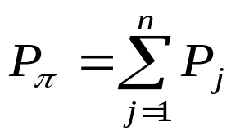
Job Scheduling with Penalties
Description of the problem:
  There are n jobs J₁,…,J_{n} to be executed one at a time. Given execution times t₁,…,t_{n}, deadlines d₁,…,d_{n} and deadlines missing penalties p₁,…,p_{n}, all being positive integers
  A schedule for the jobs is a permutation π of {1,2,…,n}, satisfying that J_{π(i)} is the i th job to be done. The total penalty for the schedule is
  where P_{j}=p_{π(j)} if job J_{π(j)} misses the deadline.
Optimization problem:
  Determine the minimum possible penalty.
Decision problem:
  Given a nonnegative integer k, is there a schedule with P_{π}≤k?

Slide 33
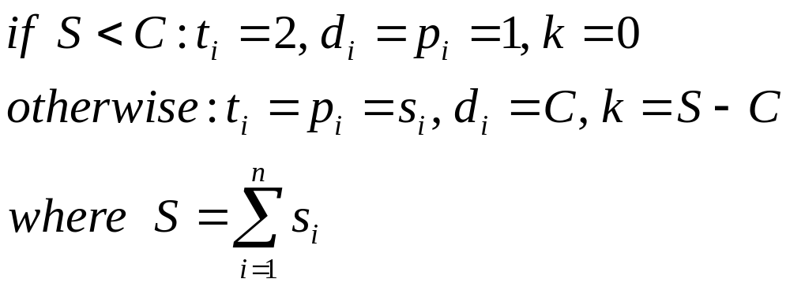
Reduction of the Subset Sum Problem
The subset sum problem is reducible to the job scheduling problem.
Transformation:
always output NO

Slide 34
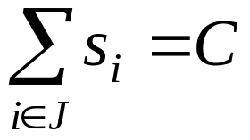
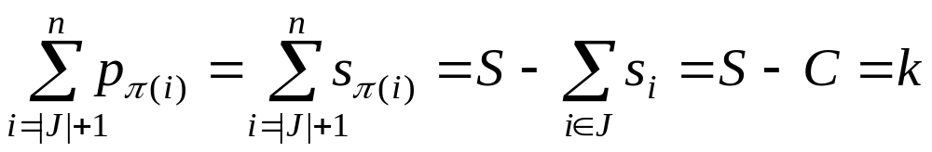
Reduction of the Subset Sum Problem
Let (s₁,s₂,…,s_{n},C) be a yes-input for subset sum problem, that is:
where J⊆{1,2,…,n}
By the definition of the reduction, the input for scheduling problem is (s₁,s₂,…,s_{n},C,C,…,C, s₁,s₂,…,s_{n},S-C). Constructing a scheduling π such as {π(1), π(2),…, π(|J|)} is exactly J.
Since , the first |J| jobs don’t miss their deadlines.
So, the total penalty, i.e. the penalty for the remaining jobs is:

Slide 35
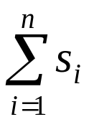
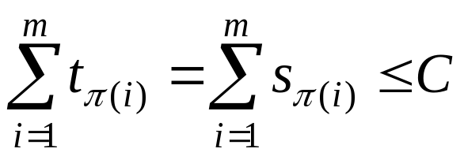
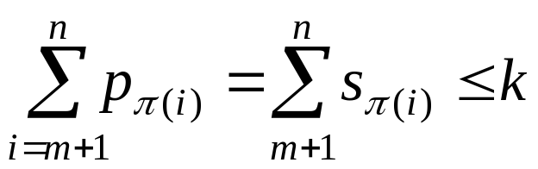
Reduction of the Subset Sum Problem
Let π be a yes-input for scheduling problem, i.e. the total penalty is no more than k=S-C. Let m jobs are completed by deadline C.
The situation is:
Penalties
0
Time
C
C
s_{π (1)}
…
s_{π (m)}
s_{π (m+1)}
…
s_{π (n)}
=S-C
However, the sum of the 2 items must be S, so the inequalities must be equalities, so, a yes-input for subset sum problem.

Slide 36
Known NP-Complete Problem
Garey & Johnson: Computer and Intractability: A Guide to the Theory of NP-Completeness, Freeman, 1979
  About 300 problems, grouped in 12 categories:
1. Graph Theory 2. Network Design 3. Set and Partition
4. Storing and Retrieving 5. Sorting and Scheduling
6. Mathematical Planning 7. Algebra and Number Theory
8. Games and Puzzles 9. Logic
10. Automata and Theory of Languages
11. Optimization of Programs 12. Miscellaneous

Slide 37
Approaches to Solve Hard Problems
Make modifications on the problem
  Restrictions on the input
  Change the criteria for the output
  Find new abstractions for a practical situation
Find approximate solution
  Algorithm
  Bound of the errors.

Slide 38
Home Assignments
pp. 600-
  13.10
  13.14
  13.17

